Slide 1
BIO STATISTICS

Slide 4
TEST FOR BINOMIAL PARAMETER (proportion)

Slide 5
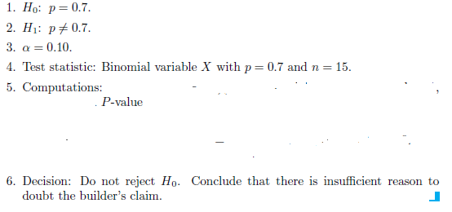
QUESTION

Slide 6
How to perform in SPSS
Generate two variables
“Pump_installed “ and “freq”
Turn on value labels as shown

Slide 7
How to perform in SPSS
Enter the data like shown here and turn on the weight cases by freq

Slide 8
How to perform in SPSS
Now click on the “Binomial” option

Slide 9
How to perform in SPSS
Enter the variable you want to test in “test varibale list”
Enter the claimed value as given in question
Now click OK

Slide 10
Output
As p-value is greater than α, so Accept the Ho

Slide 11
Questions for Practice

Slide 12
QUESTIONS

Slide 13
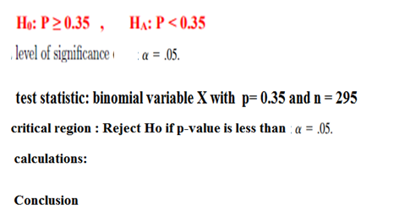
Question

Slide 14
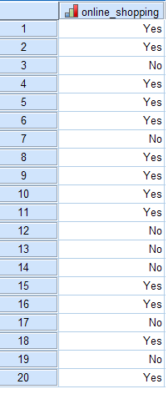
Question
In a female University it was claimed that 60 % of the students have experienced online shopping. A sample of 20 students was asked whether they ever did experience online shopping . Test the claim at 5% level of significance. The data is given as below
Ho : P=.60 H1: P≠.60
Level of significance:
Test statistic: Binomial variable X with P=.60 and n = 20
Critical region : Reject Ho if p-value is less than
Claculation: P-value=
Conclusion

Slide 15
Question
In a medical study conducted in a hospital it was claimed that at least 40% of the smokers admitted there had lungs disease. To test this claim a sample of 15 smokers was taken and identified whether they had lungs disease or not. Use 5% level of significance . The data is as below:
persons | 1 | 2 | 3 | 4 | 5 | 6 | 7 | 8 | 9 | 10 | 11
persons | 1 | 2 | 3 | 4 | 5 | 6 | 7 | 8 | 9 | 10 | 11 | 12 | 13 | 14 | 15 | 16 | 17 | 18 | 19 | 20
Status | ys | no | ys | no | no | no | ys | no | no | yes | yes | yes | no | yes | yes | no | no | no | yes | yes

Slide 16
The end

